Slide 1
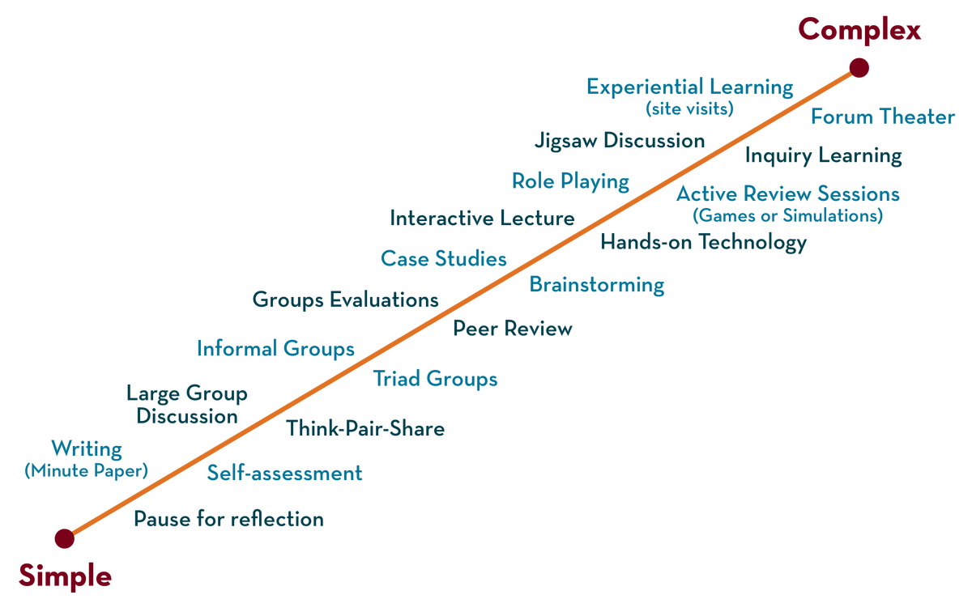

Department of CSE
Cloud & devops (EPAM)
21cs3019aa
Topic:
LINUX BASICS
Session - 3

Slide 2
Introduction
What is Linux?
A free and open-source operating system
Linux is also the kernel’s name
The operating system was originally named GNU and developed by Richard Stallman
Usually meant as “family of open-source Unix-like operating systems based on the Linux kernel.”
Implements POSIX specification and was derived from UNIX
Linux was the name of the kernel developed by Linux Torvalds in 1991
Since the GNU’s tolling and Linux kernel were frequently bundled together, people started to call the GNU OS “Linux
Notes:
Бесплатная операционная система с открытым исходным кодом
Обычно подразумевается как «семейство Unix-подобных операционных систем с открытым исходным кодом, основанных на ядре Linux».
Реализует спецификацию POSIX и является производным от UNIX.
Линукс, это так же имя ядра:
Операционная система изначально называлась GNU и была разработана Ричардом Столлманом.
Linux - это название ядра, разработанного Linux Torvalds в 1991 году.
Поскольку использование GNU и ядро Linux часто объединялись, люди начали называть ОС GNU «Linux».

Slide 3
Linux
Why Linux?
Linux runs on >75.3% of public web servers
It is used on:
Servers (DNS, Web, File server, etc)
Workstations (As a free alternative to Windows / Mac OS)
Supercomputers (Used on 100% supercomputers as of 2021)
Smartphones (Android, Sailfish, Pine OS)
Network equipment (Firewalls, switches, routers)
Gaming consoles (Valve SteamBox)
Televisions
… and many more devices

Slide 4
Unix and Unix philosophy
UNIX is the predecessor of Linux, from which it borrows heavily.
Unix systems are characterized by a modular design that is sometimes called the "Unix philosophy". According to this philosophy, the operating system should provide a set of simple tools, each of which performs a limited, well-defined function – “Make each program do one thing well”
Write programs that do one thing and do it well.
Write programs to work together.
Write programs to handle text streams, because that is a universal interface.
These principles are still valid today. Most shells – and shell utilities – follow them.
Every time you’ll work with the Linux shell, you’ll use programs built on these principles.
Unix philosophy: documented by Douglas McIlroy in 1978:

Slide 5
What comprises a Linux distribution?
Applications
Package manager
Bootloader
Kernel
Init system
Graphics system

Slide 6

Linux distributions
Linux OS has multiple distributions (AKA distros)
Most of them are free and open-source
Examples:
ArchLinux
Debian
Ubuntu
CentOS
Mint
Gentoo
OpenSUSE

Slide 7

Linux distributions (II)
There are also non-free distributions available, such as:
The main difference between free and paid distributions is paid support – and some paid repositories.
Red Hat Enterprise Linux
Oracle Linux
SUSE Linux Enterprise Server
Scientific Linux
Astra Linux Special Edition

Slide 8


Linux distributions (III)
The most popular families are RedHat or Debian derived
Most popular RedHat-like distributions are:
Most popular Debian-like distributions:
Debian
RHEL
CentOS
Oracle Linux
Fedora
Ubuntu
MX Linux
Linux Mint

Slide 9
Linux shells
From wiki: “A Unix shell is a command-line interpreter or shell that provides a command line user interface for Unix-like operating systems. The shell is both an interactive command language and a scripting language, and is used by the operating system to control the execution of the system using shell scripts.”
Most popular Linux shells are:
Main similarities and differences between shells:
All of them support POSIX shell features (redirection, etc), though some (bash) do not follow the standard in every aspect.
Bash
Zsh
Dash
Fish
Some of them implement their own data structures – arrays, dictionaries
There are other differences – such as autocompletion, inline wildcard expansion and variable transformation

Slide 10
Useful links
Unix
Linux
History of Linux - Wikipedia
History of Unix – Wikipedia
Linux distribution - Wikipedia

Slide 11
Practice
Install any Linux distribution mentioned in this presentation on either a virtual machine or a physical one.
Tip: oracle cloud (Cloud Infrastructure | Oracle) provides 2 always-free VMs.
For a local, virtualbox installation see official documentation and Ubuntu guide (applicable to most other distros as well)

Slide 12
Linux
Basic Command Line Skills

Slide 13
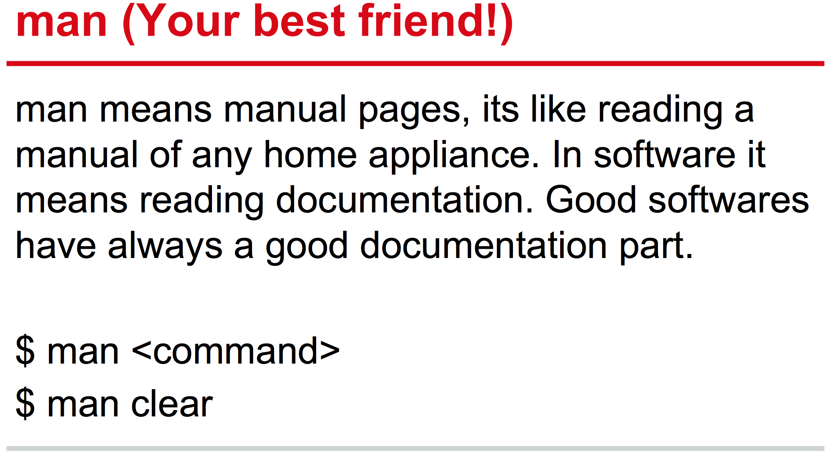
Commands
Notes:
Можно даже выполнить man man, чтобы прочитать про саму утилиту man
Об этом не рассказывать, нужно для дальнейшей практики.
Создадим файлик для примера, чтобы потом с ним можно было работать.
man man > file

Slide 14
Commands
The apropos command displays a list of all topics in the man pages (i.e., the standard manual that is built into Unix-like operating systems) that are related to the subject of a query.
It is particularly useful when searching for commands without knowing their exact names.
$ apropos rename

Slide 15
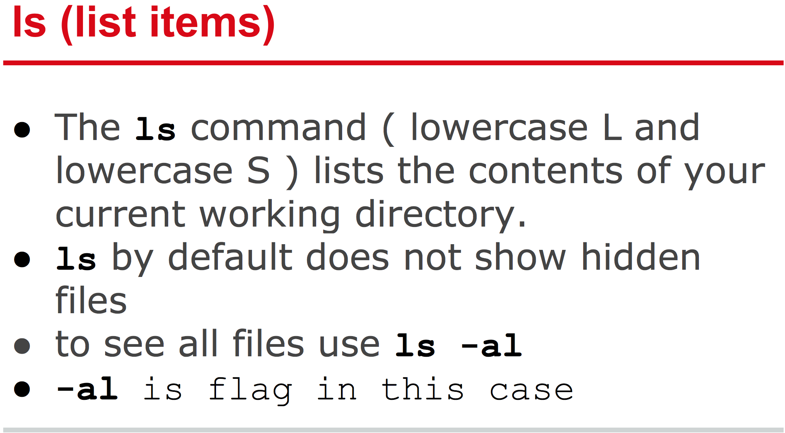
Commands

Slide 16
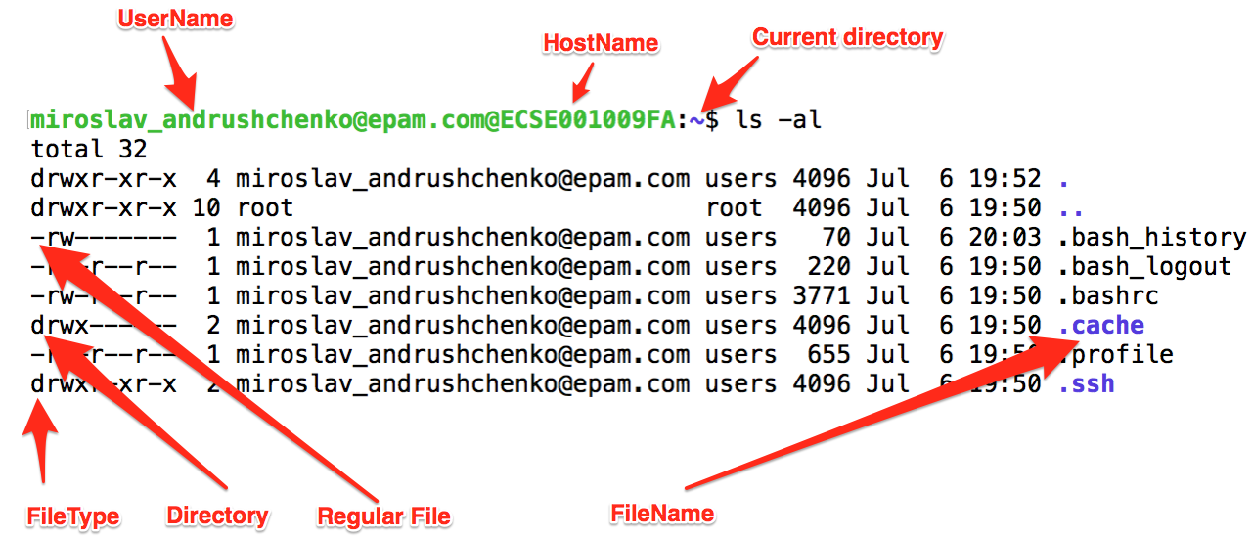
ls –al output

Slide 17
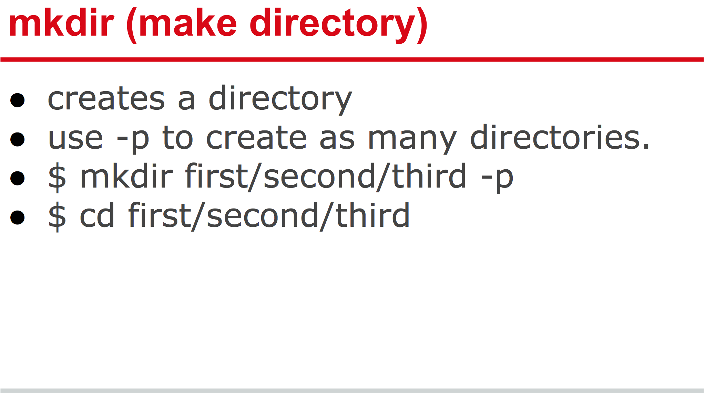
Commands

Slide 18
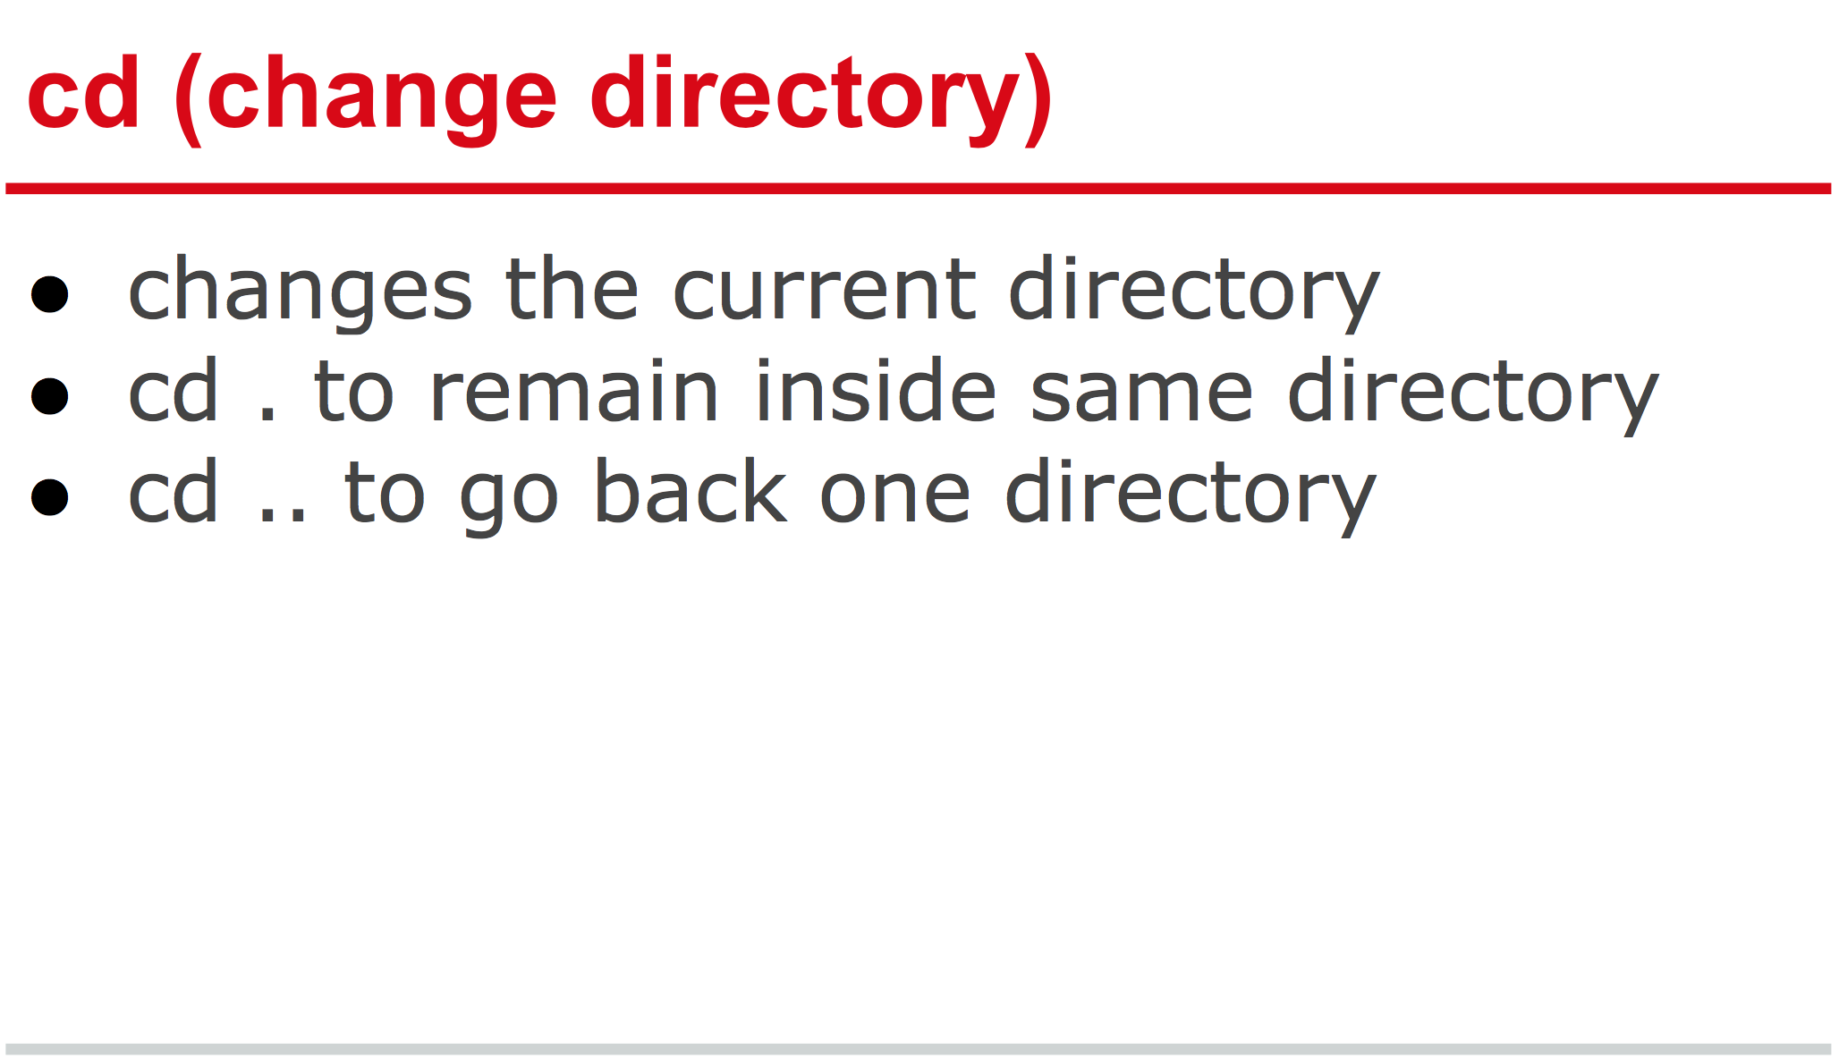
Commands

Slide 19
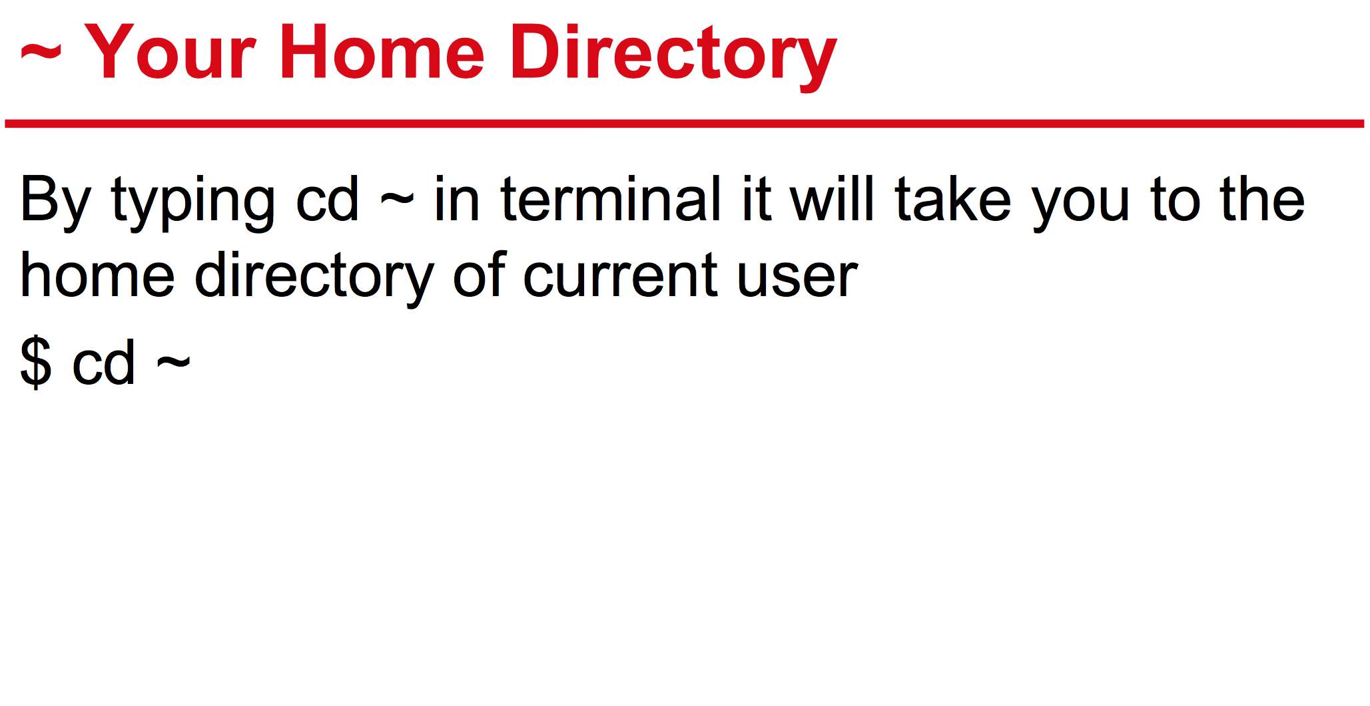
Commands
~student means home directory of user with name ‘student’
$ cd ~root – will take you to the home directory of the user ‘root’

Slide 20
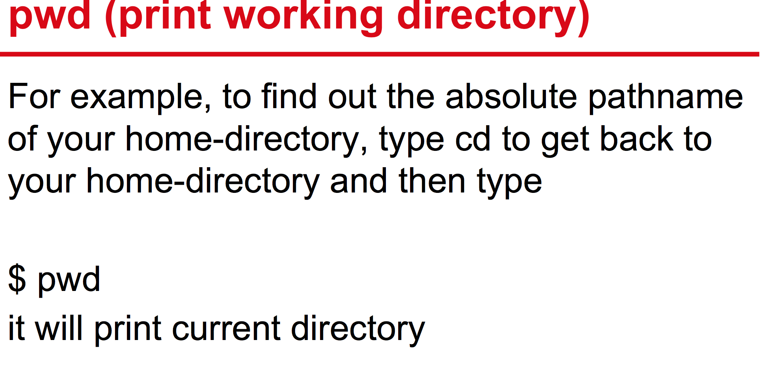
Commands

Slide 21
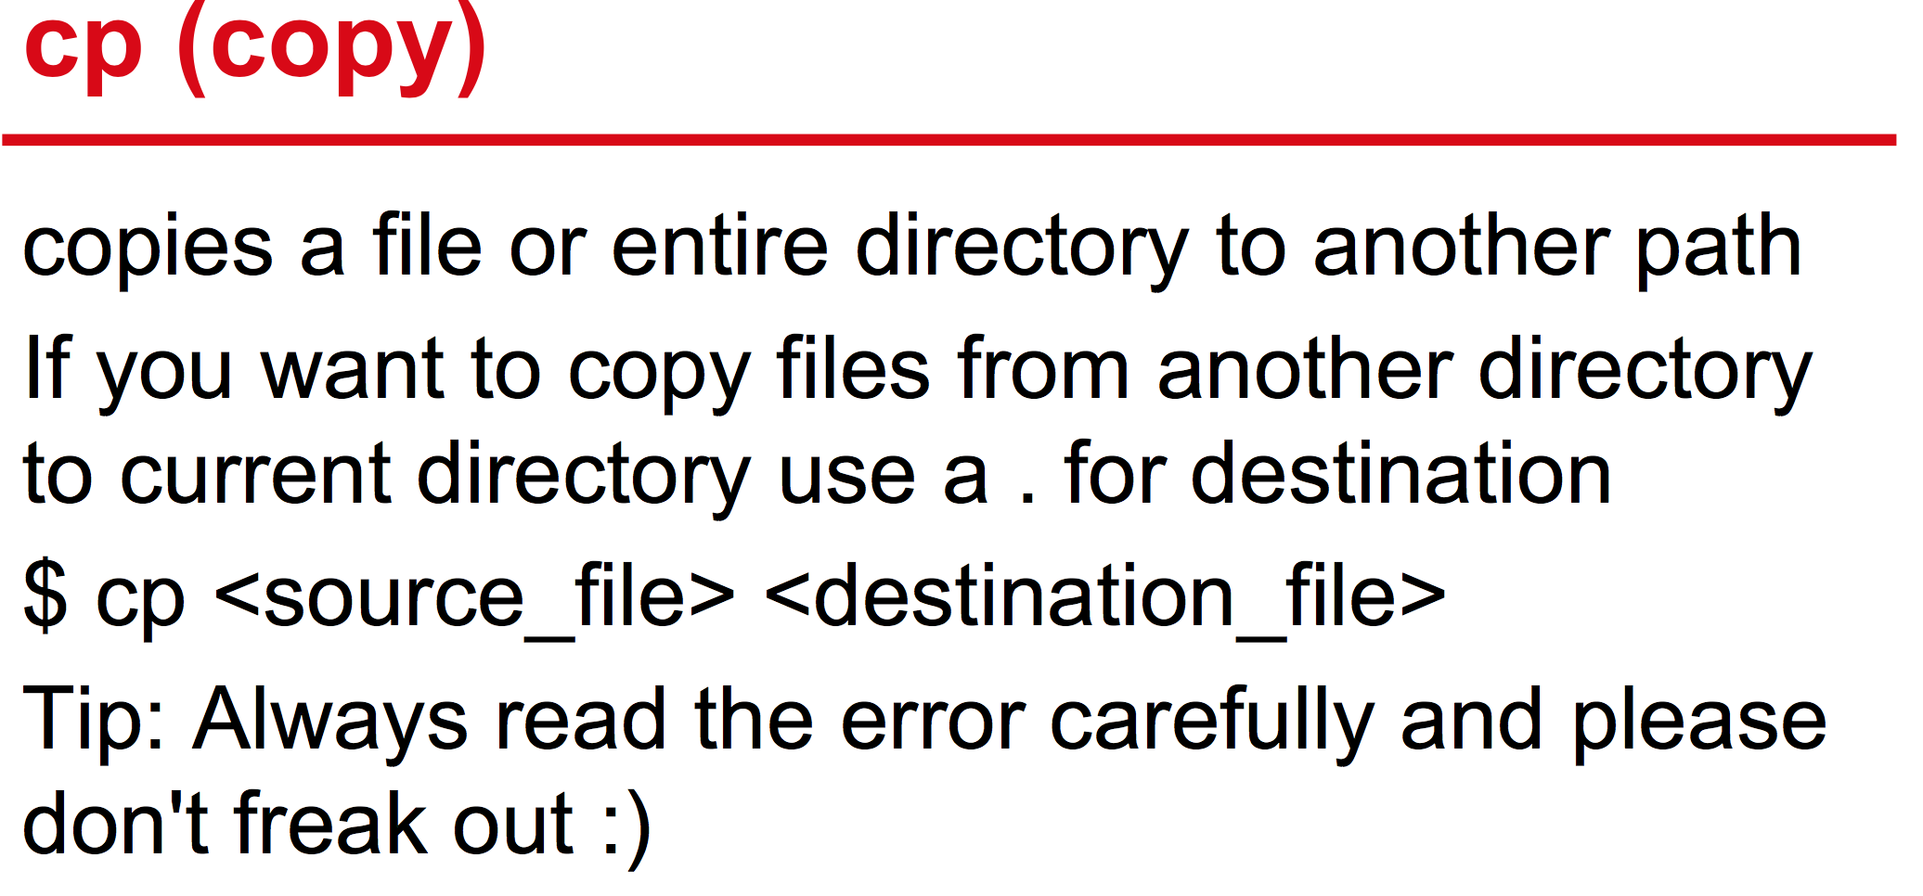
Commands
NOTES: To recursively copy folders and files, use the -r key

Slide 22
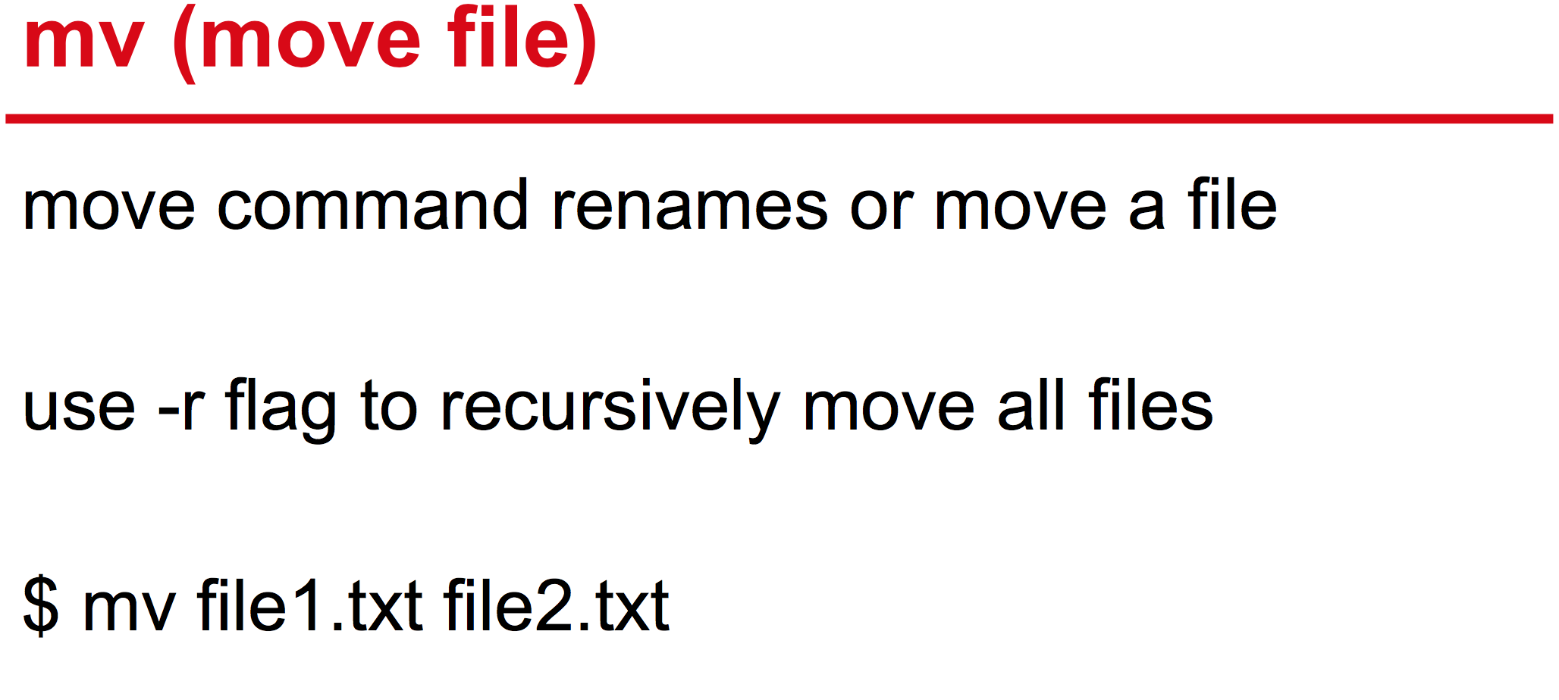
Commands

Slide 23
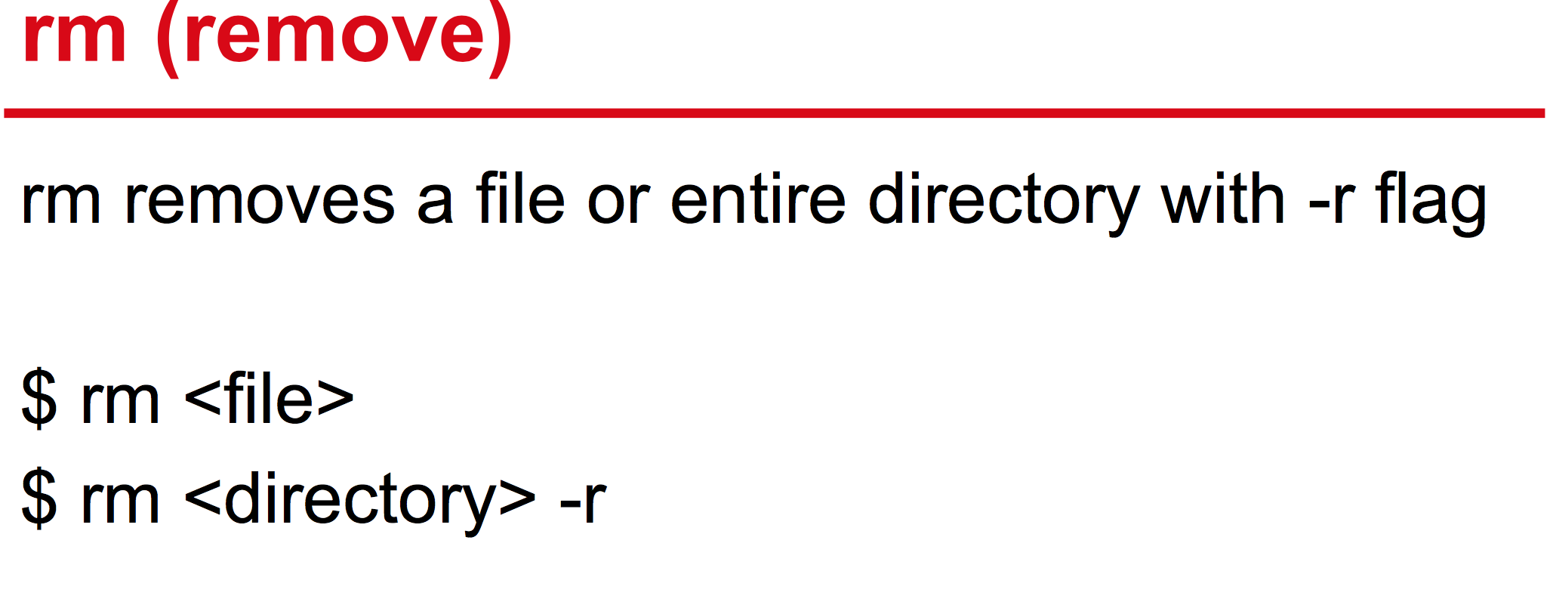
Commands

Slide 24
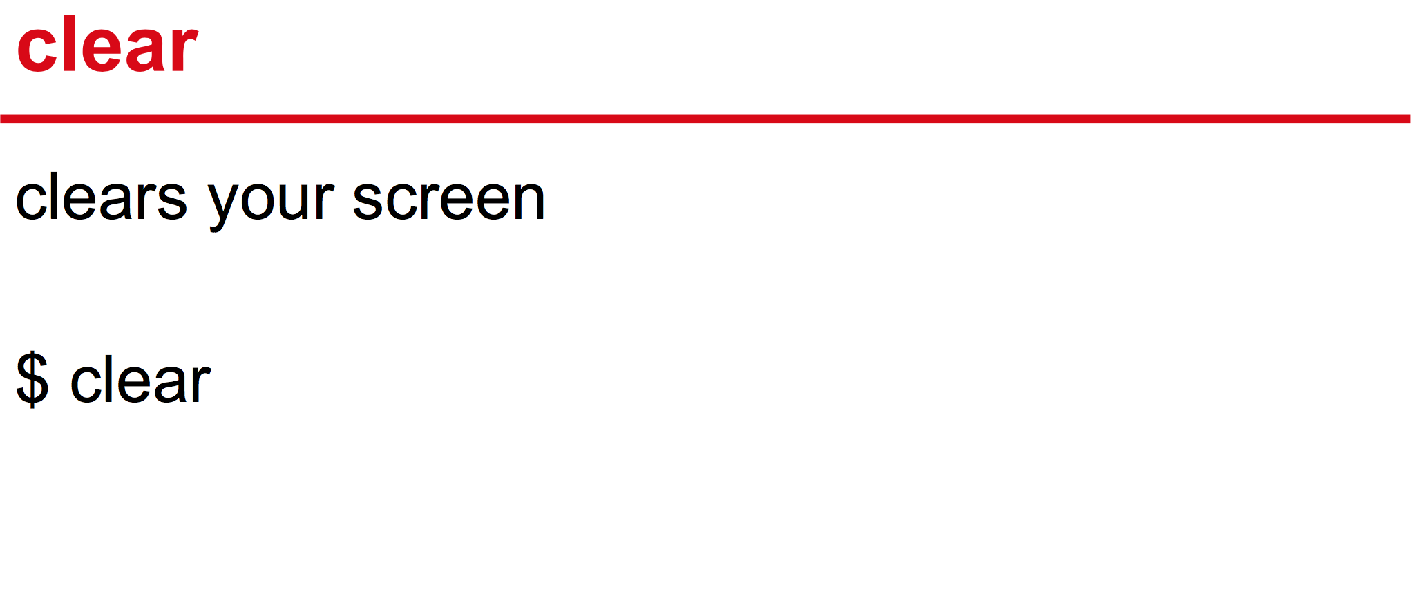
Commands

Slide 25
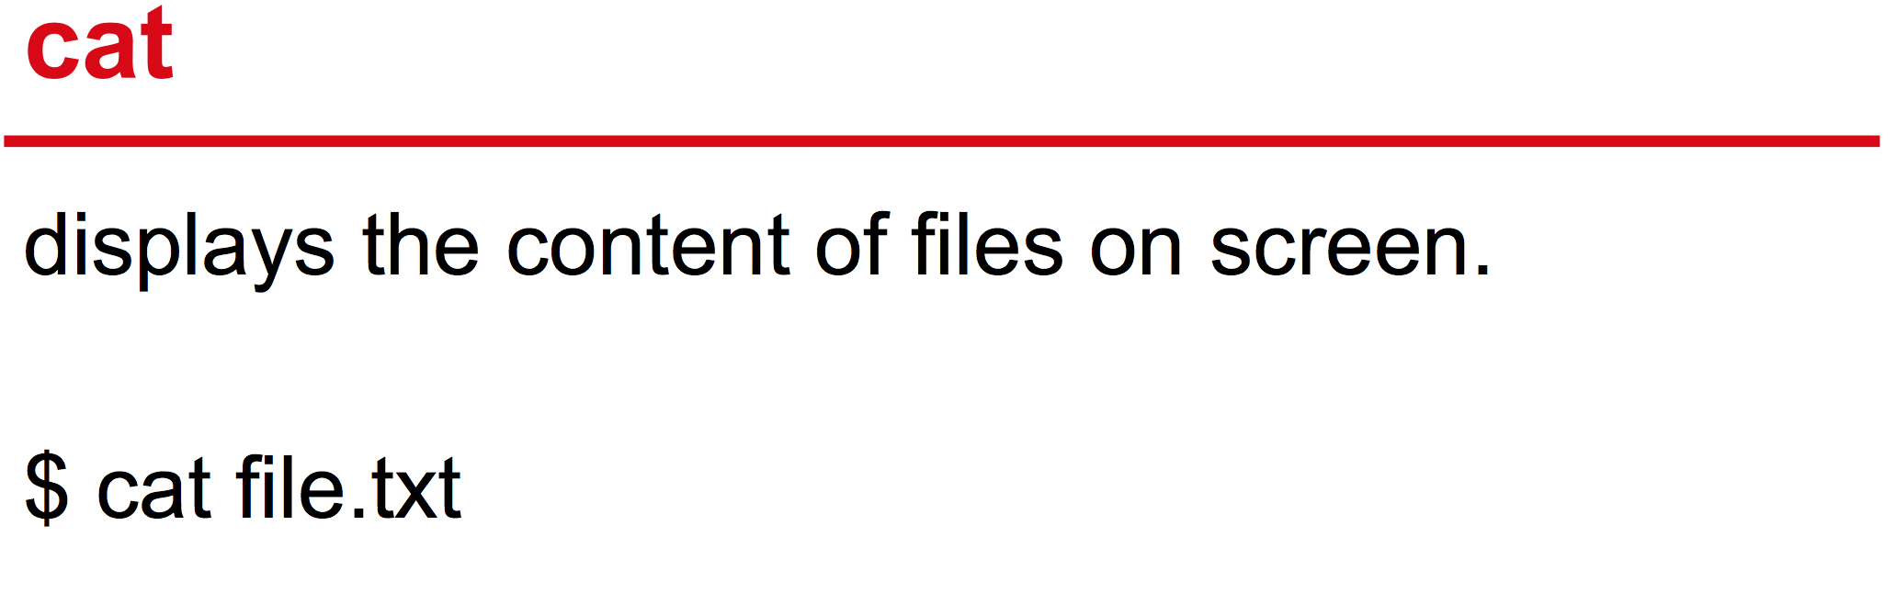
Commands

Slide 26
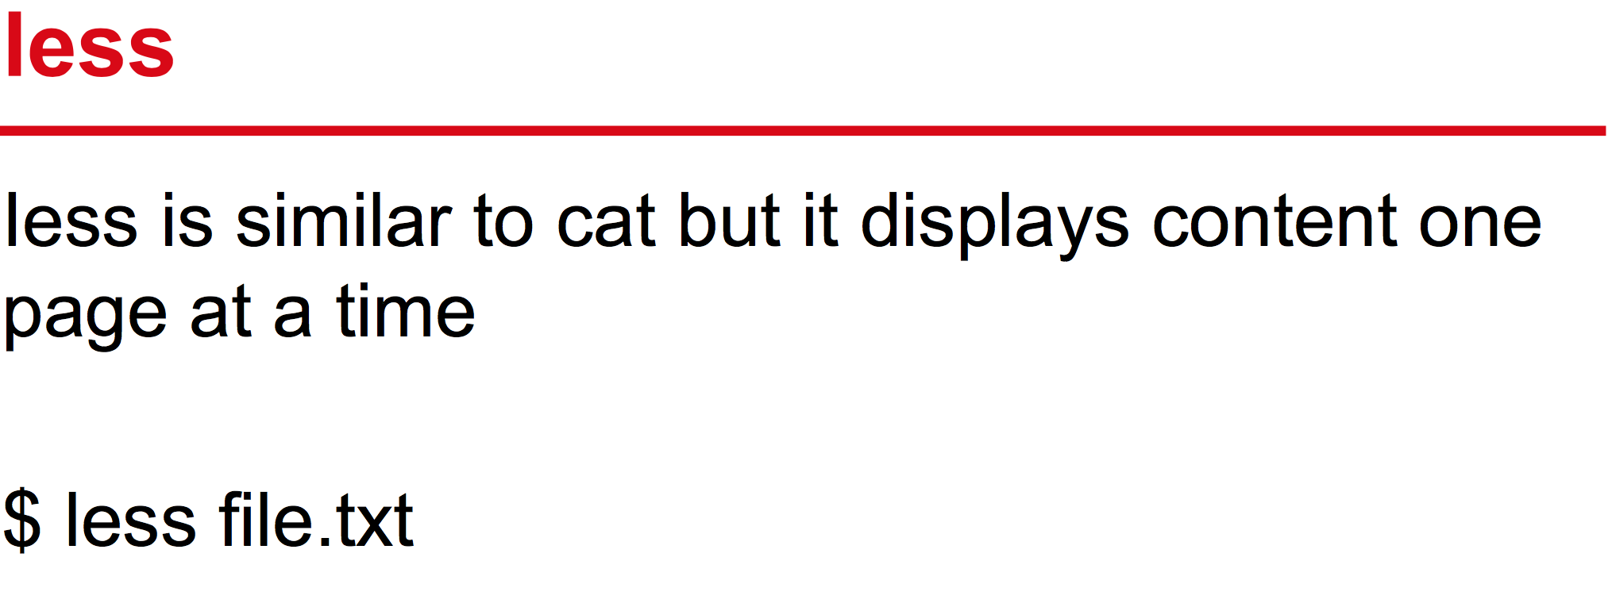
Commands

Slide 27
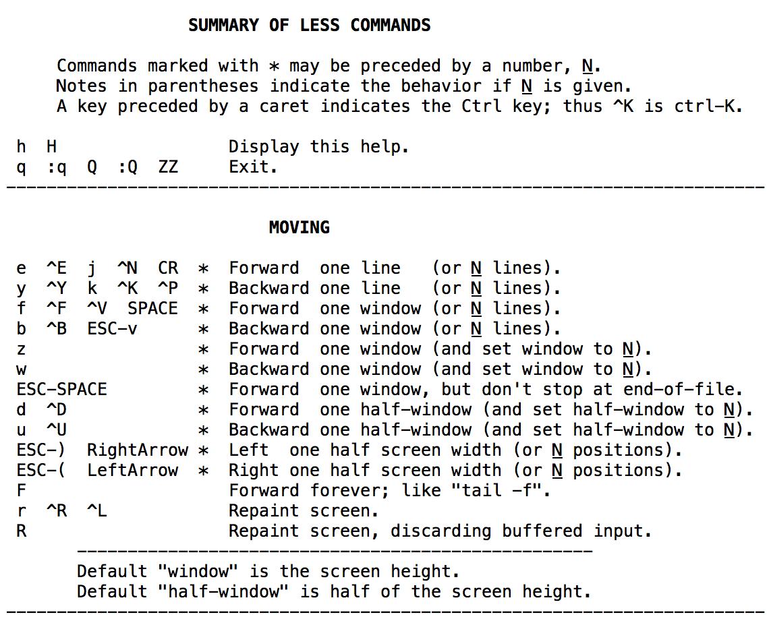
More and navigation

Slide 28
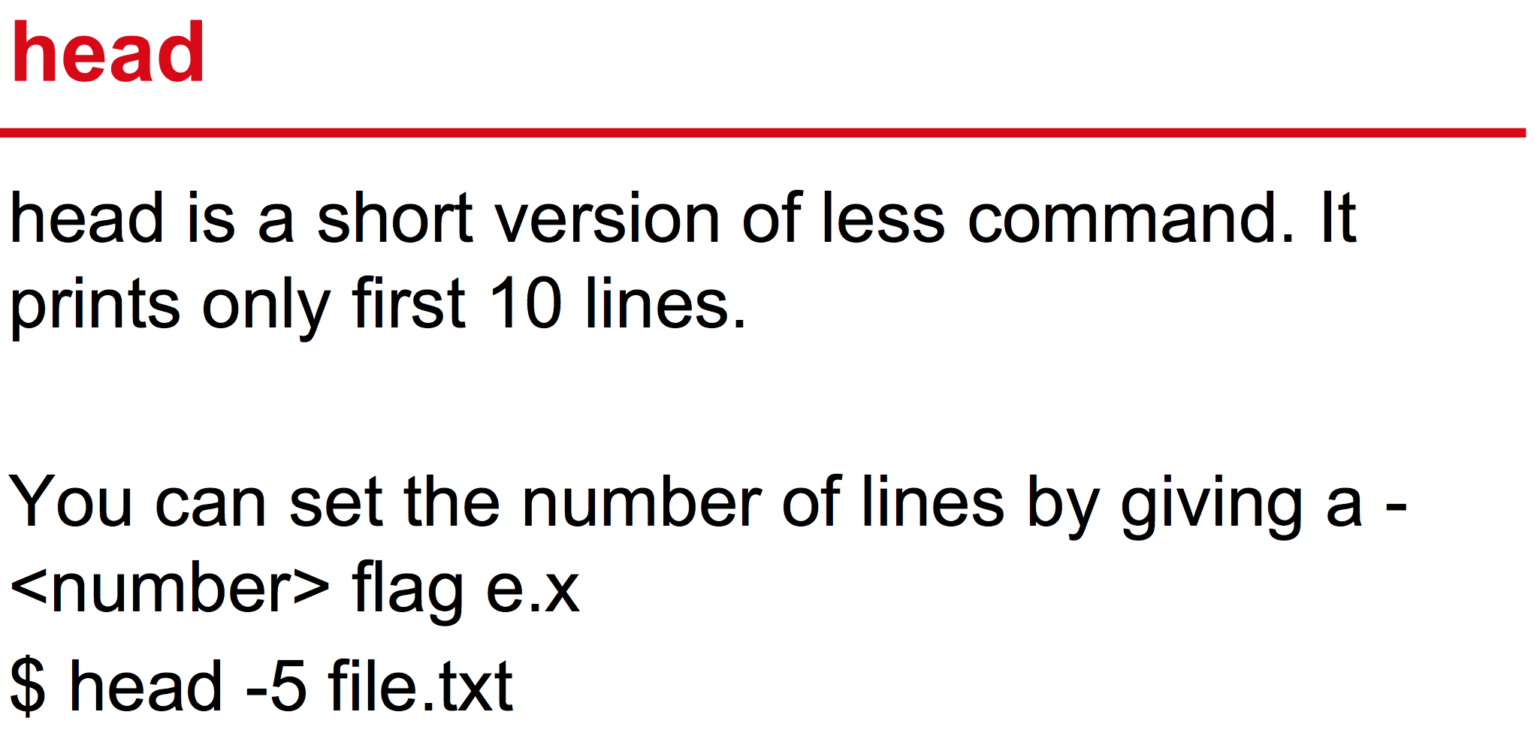
Commands

Slide 29
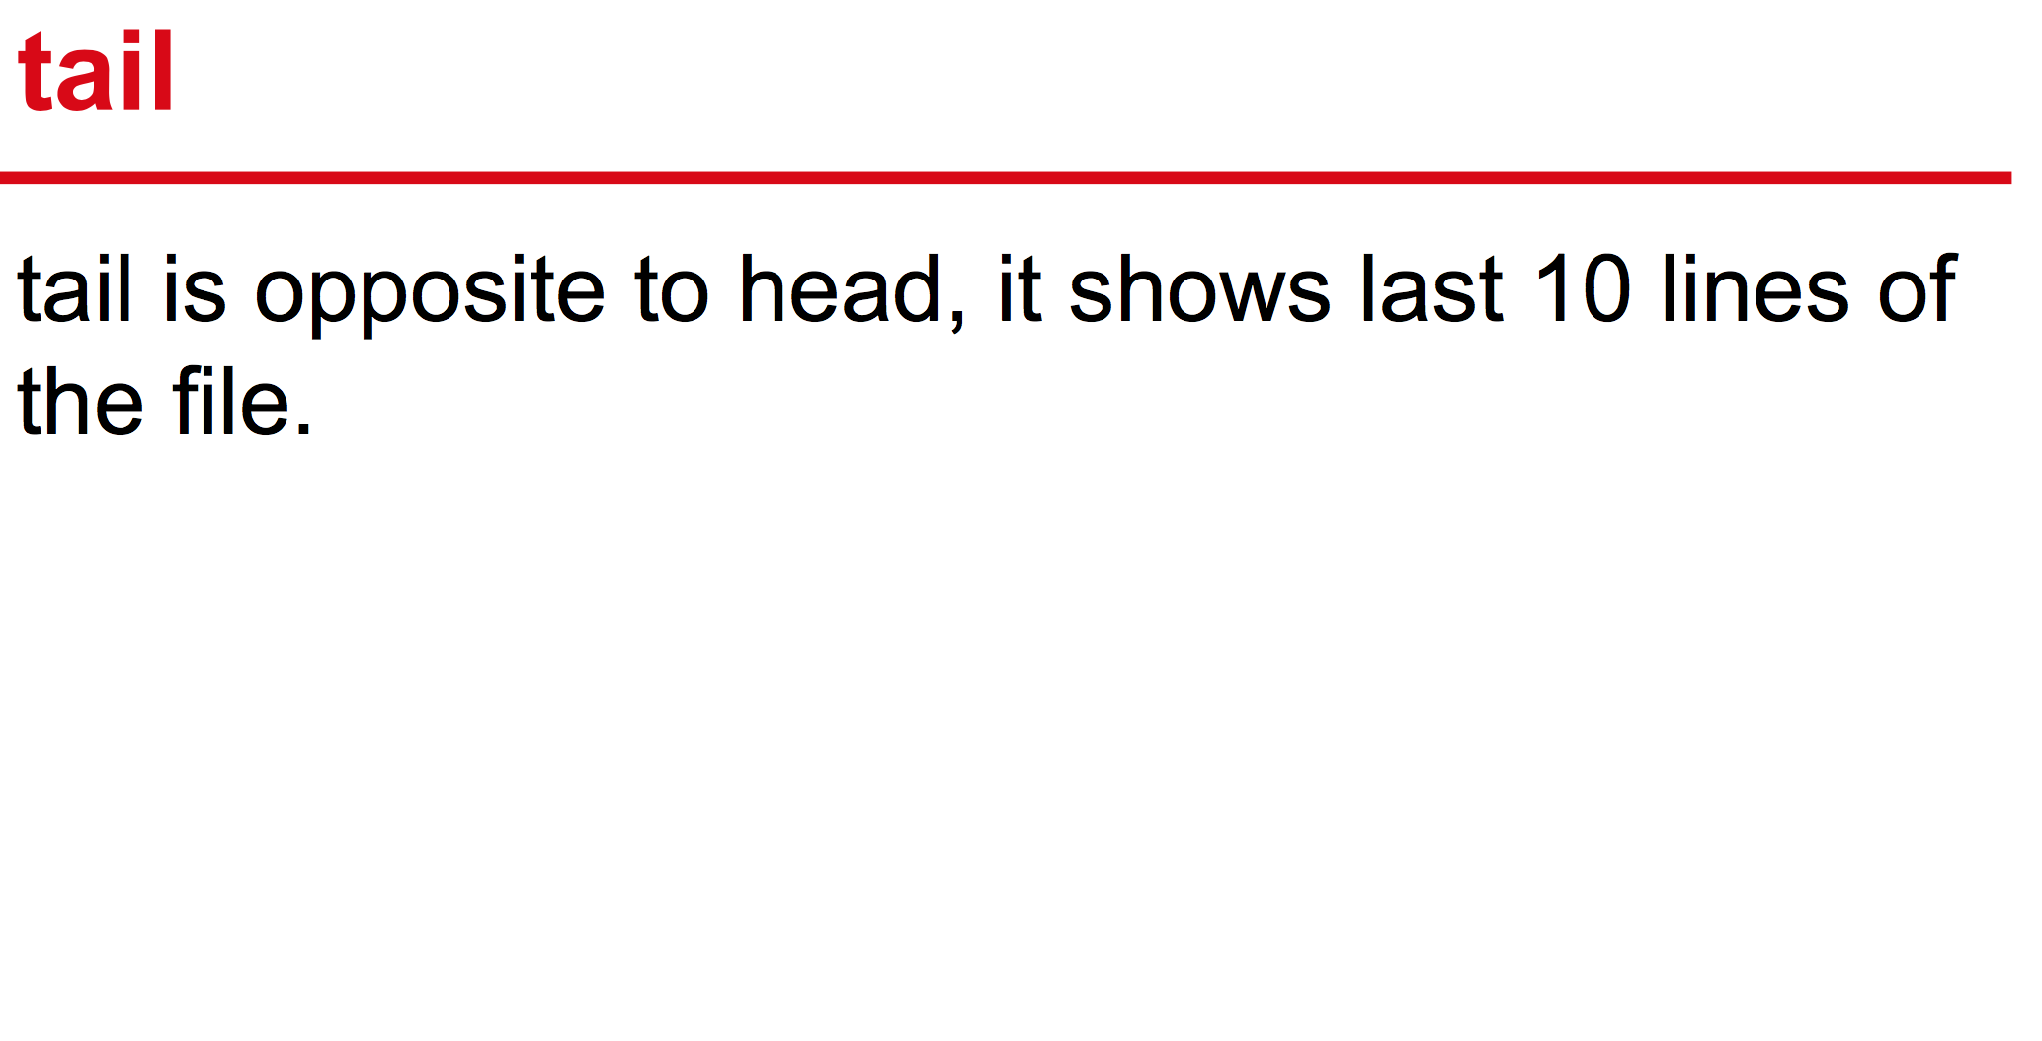
Commands
NOTES: To view the file in real time, use the -f key

Slide 30
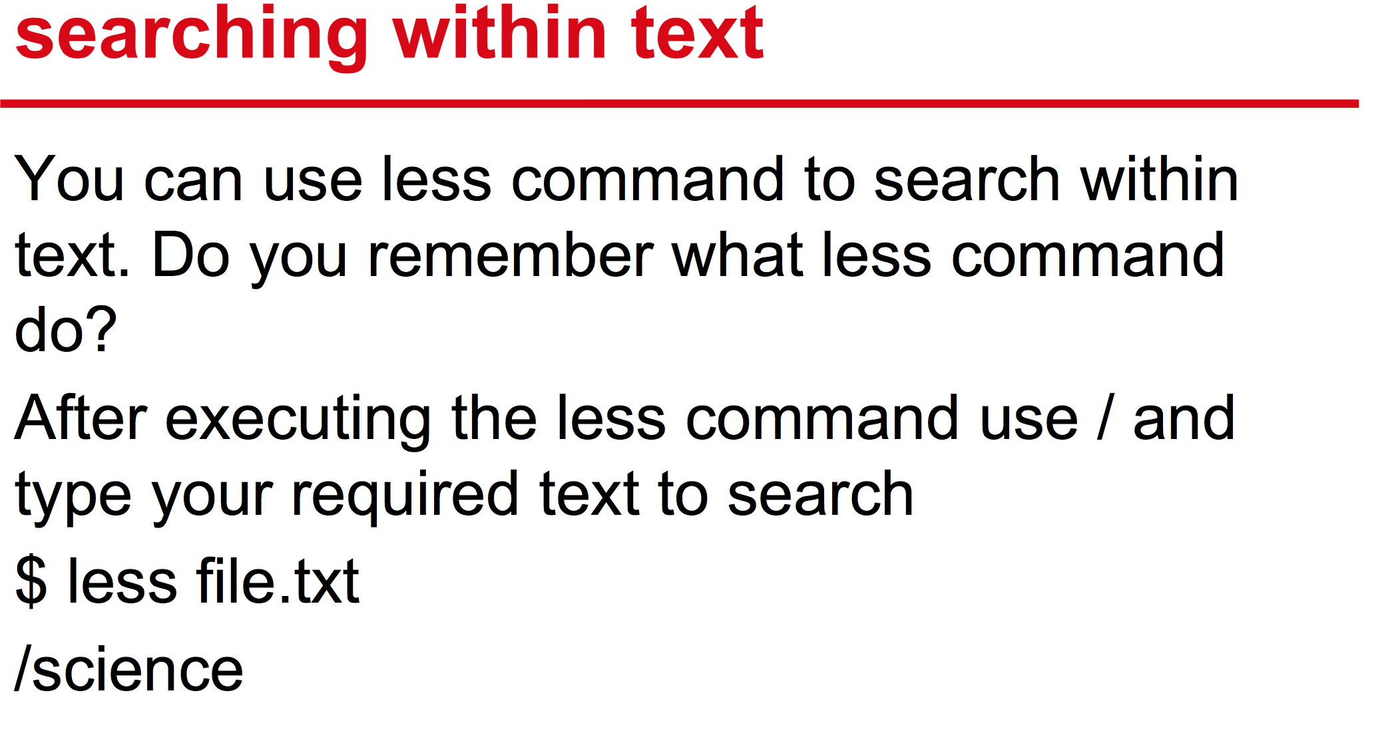
Commands

Slide 31
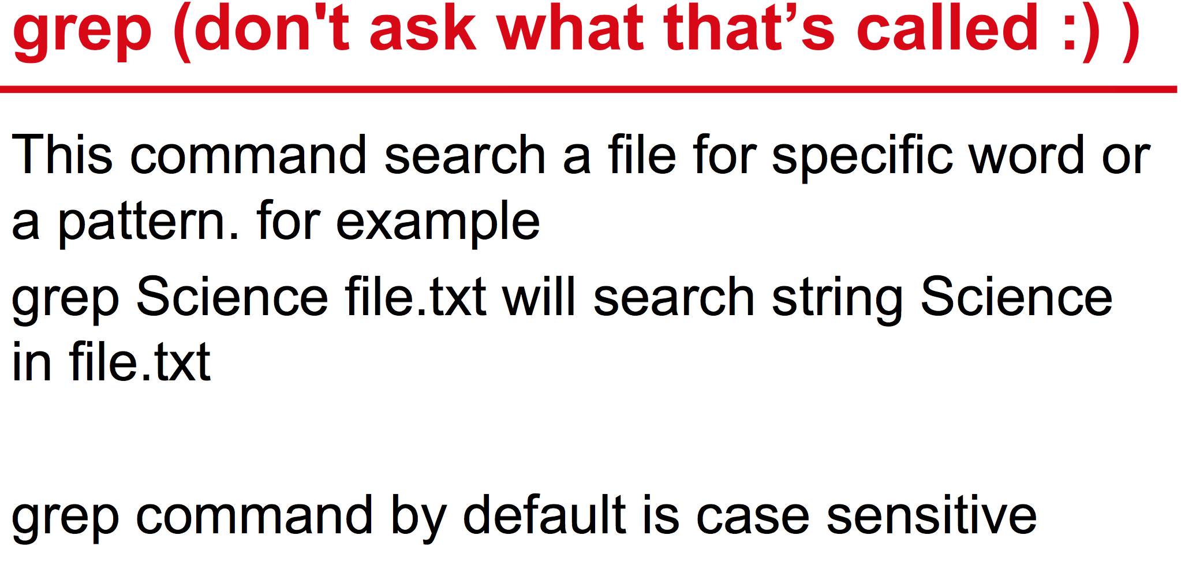
Commands

Slide 32
Commands
Sed
Example:
$ sed options file
$ echo "This is a test" | sed 's/test/another test/’
$ sed 's/test/another test/' ./myfile

Slide 33
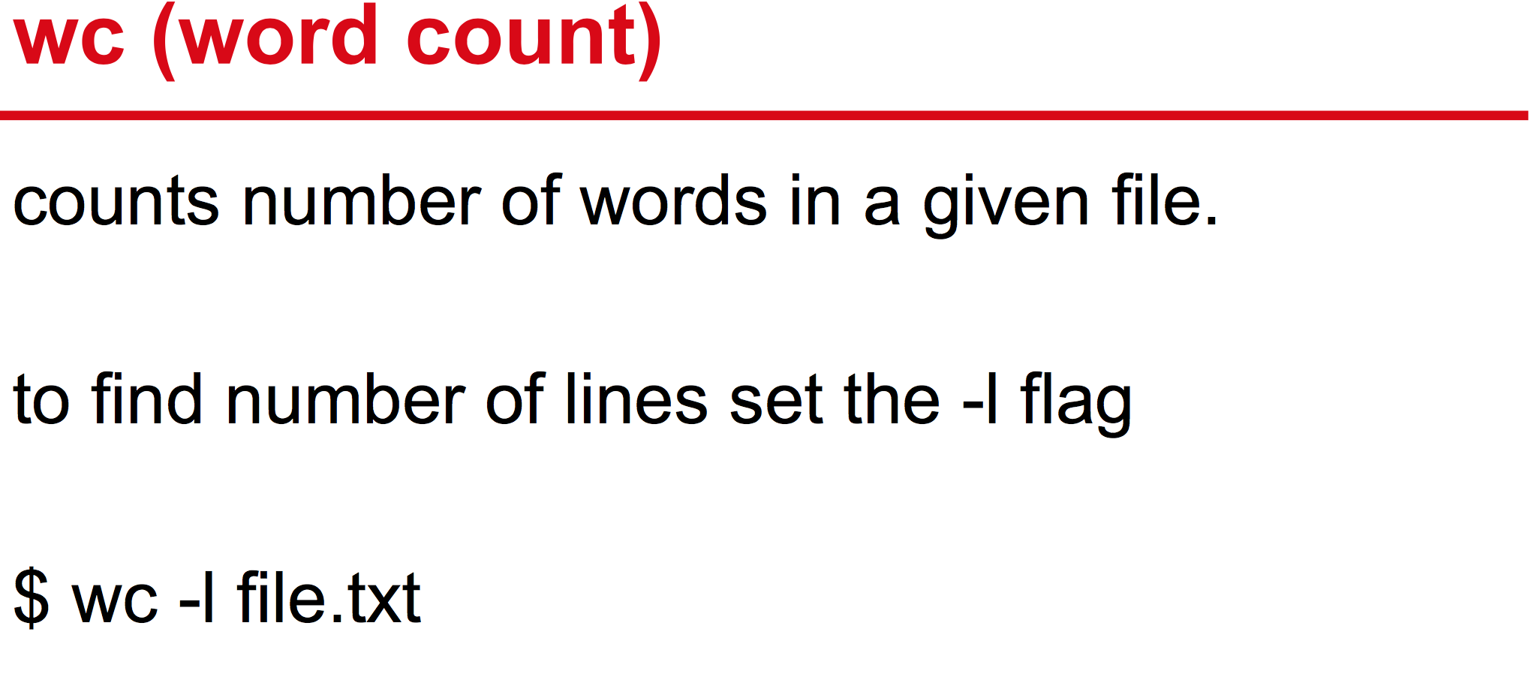
Commands

Slide 34
command1 | command2
| – transfer command1 output to command2 input
Example:
$ ls –la | grep mp3
$ ps –ef | less

Slide 35
command1 > file
> – redirects command output to file (instead of terminal). File will be rewritten if exists.
Example:
$ ls –la > file
$ cat file
...

Slide 36
command1 >> file
>> – redirects command output to file (instead of terminal). File will be upended if exists.
Example:
$ ls –la /home/Linus >> file
$ ls –la /home/Mary >> file
$ cat file
...

Slide 37
The Linux Standard Streams
0: stdin
1: stdout
2: stderr
Example:
$ < file
$ > file
$ 2> file
$ >>file
$ 2>>file
$ &>file

Slide 38
Here Document
Example:
cat <<EOF
This is line1
Another line
Finally 3rd line
EOF

Slide 39
Here String
Example:
cat <<< "This is a string“
---
WELCOME_MESSAGE="Welcome to dashboard"
cat <<< $WELCOME_MESSAGE

Slide 40
Practice
1. Log in with your username / password
2. Create a directory lesson1 in your exercise home directory and navigate to it
3. Create files f1 and f2, as well as the dir1 directory and the dir2 file in it
4. Copy dir1 to dir2 with all files
5. Remove dir1
6. Copy the file / etc / services to the lesson1 directory
7. Output all lines containing HTTP and copy to file f1
8. Count the number of lines in it and copy this number to file f2
9. Examine the more, less, tail, head commands in the services file
10. Investigate the commands cal, bc
11. Find out the date of Orthodox Easter in 2051.

Slide 41
Links
STDIN, STDOUT, STDERR - https://meliorem.ru/tools/linux/rabota-s-potokami-stdin-stdout-stderr/
Opennet sed - https://www.opennet.ru/man.shtml?topic=sed&category=1

Slide 42
Linux File System and Permissions

Slide 43
File systems overview
File system or filesystem (often abbreviated to fs) is a method and data structure that the operating system controls how data is stored and retrieved.
There are many different kinds of file systems. Each one has different structure and logic, properties of speed, flexibility, security, size and more.

Slide 44
File systems types
A disk file system takes advantages of the ability of disk storage media to randomly address data in a short amount of time. Some disk file systems are journaling file systems or versioning file systems.
Examples: FAT (FAT12, FAT16, FAT32), exFAT, NTFS, APFS, ext2, ext3, ext4.
A network file system is a file system that acts as a client for a remote file access protocol. Programs using local interfaces can transparently create, manage and access hierarchical directories and files in remote network-connected computers.
Examples: NFS, AFS, SMB protocols.

Slide 45
Special file systems
In the Linux kernel, configfs and sysfs provide files that can be used to query the kernel for information and configure entities in the kernel.
Procfs maps processes and, on Linux, other operating system structures into a filespace.

Slide 46
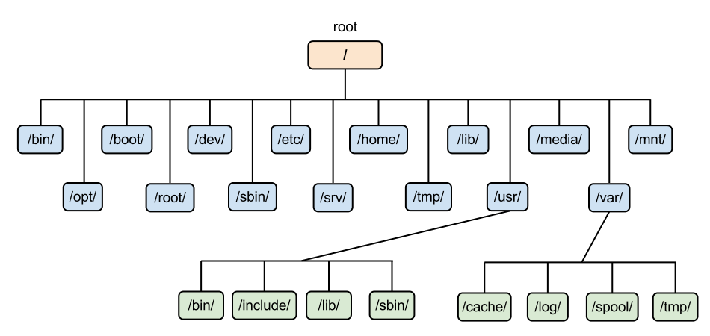
Linux file system hierarchy

Slide 47
Common directories (man hier)
path | appointment
/boot | bootloader files
/bin | binary executable files
/etc | configuration data
/var | program data
/tmp | temporary files
/home | /root | home directories
/usr | user applications files
/dev | devices (virtual)
/proc | processes (virtual)
/run | runtime data (virtual)

Slide 48
File system devices
File systems are usually created on:
Partitions (like /dev/sdaY) - region of a disk with the set boundaries (certain amount of consequent disk sectors).
Logical volumes (like LVM, RAID, dm-crypt) - special logical storage devices that might span across multiple disks and partitions.
Regular files (like /dev/loopY) - files in a system that are accessible as a block devices
Identify current mounted devices with commands:
lsblk –f
df -T

Slide 49
File system commands
mkfs.X
mount/unmount
parted
findmnt
tune2fs, resize2fs
df/du (ncdu as more interactive alternative for du)
fsck/e2fsck
dump
mdadm
dd

Slide 50
Content of /etc/fstab
filesystem – device from /dev/, UUID, etc
dir – target folder in the file system hierarchy
type – type of the file system (ext4,ext2,xfs,etc)
options – describes other aspects of the file system
dump – option for backed up behaviour by the dump program
pass – option for file system check behaviour by the fsck program

Slide 51
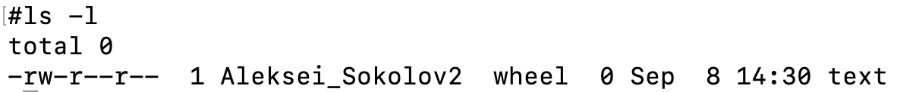
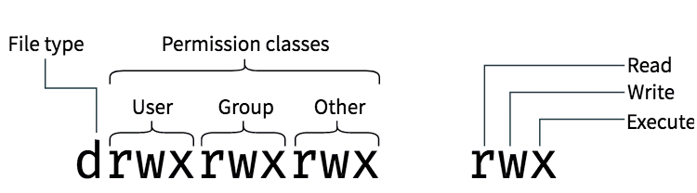
Viewing permissions and ownership
Use ls -l to display file system object permissions and ownership.

Slide 52
Effects of permissions on files and directories
Numeric | Symbolic | File actions | Directory actions
4 | r (read) | Read contents | List contents
2 | w (write) | Change contents | Modify object names
1 | x (execute) | Run executable code | Navigate to directory

Slide 53
Special permissions
Setuid and setgid bits substitute the user / group executing a binary file with the file’s owner / group. They also enforce ownership of newly created files when applied to directories.
Sticky bit limits file deletion and name modification to respective owners / groups.

Slide 54
Managing ownership
Use chown to change the owner and group of a file system object.
Syntax: chown <user>:<group> <object path>
Group can be omitted. To specify the group only, omit the user, but leave the semicolon.
Examples: chown alice:employees file.txt
chown alice file.txt
chown :employees file.txt

Slide 55
Managing permissions
Use chmod to modify file system object permissions.
Syntax: chmod <permissions> <object path>
Chmod supports numeric as well as target-operation-permission notation.
Targets are u for user, g for group, o for everyone and a for all of the above.
Supported operations are + for granting, - for revoking and = for setting explicitly.
Examples: chmod 755 file.txt chmod u+x file.txt chmod a-rw file.txt
chmod ug=rx,o=r file.txt

Slide 56
Special attributes and access lists
Additional attributes may be set on files, e.g. to allow contents a file to be added upon, but not rewritten, or to prevent file renaming or deletion. These attributes are set with chattr and may be viewed with lsattr.
Linux uses simple POSIX permissions that are limited in flexibility. Fine-grained control might be achieved with access control lists (ACLs). ACLs may be defined by using setfacl and viewed with getfacl.

Slide 57
Default permissions and access masks
Default file system object permissions are defined by the programs that create them.
For example, text editors create files to be readable and writeable, but not executable, by everyone; binary executables are created executable by the compilers.
To further limit the permissions that may be assigned to file system object by different programs, a file permission creation mask, or umask, is used. The mask defines which permissions can be set by a particular process and is assigned to said process. If any process attempts to set less restrictive permissions, these permission will not be applied.

Slide 58
Troubleshooting examples
Give as much cause as you can for this situations:
Situation 1. You aren't able to modify files with error Permission denied.
Situation 2. You aren't able to modify files with error No Space Left on Device.
Situation 3. You aren't able to open files with error Input/output error
Situation 4. You aren't able to mount device with error wrong fs type, bad option, bad superblock on ...

Slide 59
Practice
Create new volume in VirtualBox, attach it to VM
Create two partitions. One of it should be formatted in ext3, second in BTRFS
Mount into your system as /homework/ext & /homework/btrfs
They should be mounted after reboot

Slide 60
Useful links
How Basic Disks and Volumes Work - https://docs.microsoft.com/en-us/previous-versions/windows/it-pro/windows-server-2003/cc739412(v=ws.10)?redirectedfrom=MSDN#w2k3tr_basic_how_wvxg
How To Create a Partition Using “parted” Command -https://www.thegeekdiary.com/how-to-create-a-partition-using-parted-command/
Filesystems - https://tldp.org/LDP/sag/html/filesystems.html
Simple File System -https://www3.nd.edu/~pbui/teaching/cse.30341.fa17/project06.html
Everything You Ever Wanted to Know About inodes on Linux - https://www.howtogeek.com/465350/everything-you-ever-wanted-to-know-about-inodes-on-linux/
An introduction to the Linux /etc/fstab file - https://www.redhat.com/sysadmin/etc-fstab

